Slide 1



Unit 3 We all like PE!

Slide 2


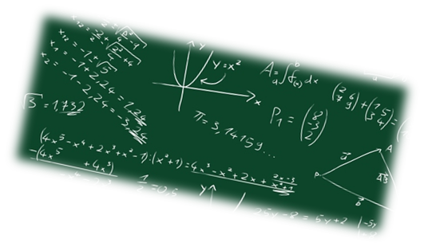
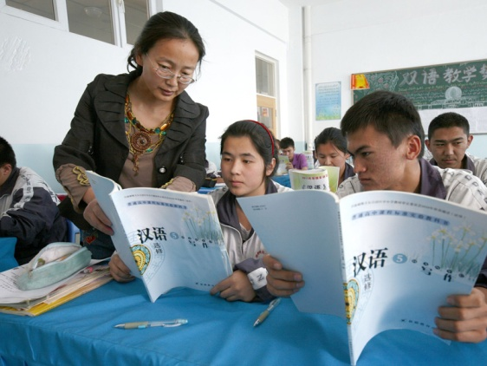
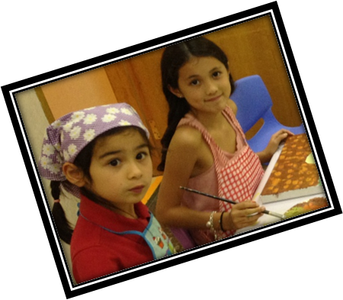
maths
English
Chinese
art

Slide 3
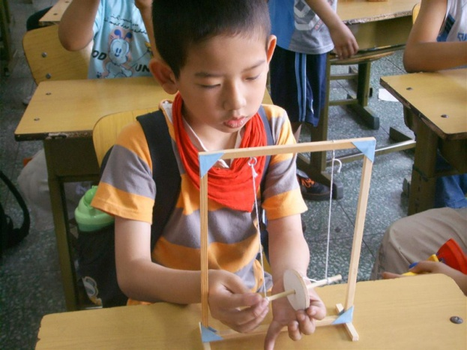

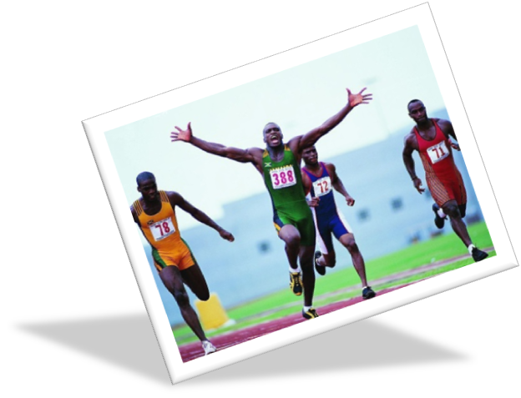
science
music
PE

Slide 4
Let’s learn!

Slide 5

A:We have…today.
我们今天有…
B: I like…/It’s…
我喜欢······/它…

Slide 6
Let’s talk!

Slide 7

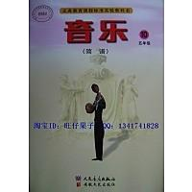
I like music.
It’s fun and easy.

Slide 8
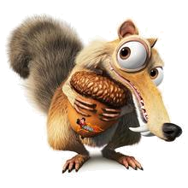

I like Chinese.
It’s fun and easy.

Slide 9
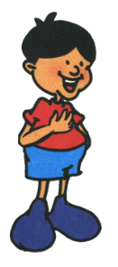

I like Maths.
It’s fun.

Slide 10
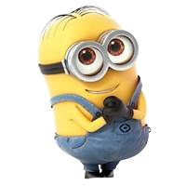

I like art. It’s fun.

Slide 11

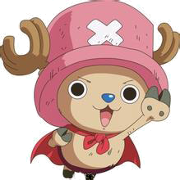
What classes do you have on Monday?
I have PE and English.

Slide 12
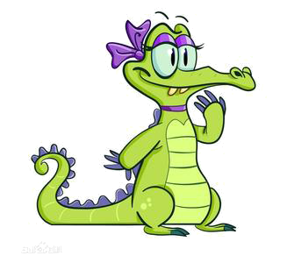
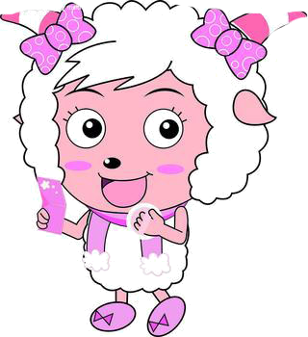
I have science, art and maths.
What classes do you have on Friday?

Slide 13


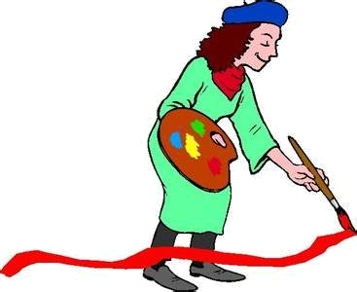
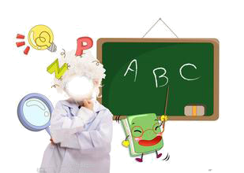
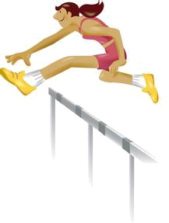

PE
English
art
music
maths

Slide 14

和身边小伙们说说，
你喜欢那些科目。

Slide 15
See you!

